Slide 1
CSC3003S Test 2 review
Cael Marquard
(comics herein are jokes and sadly not worth marks)

Slide 2
General comments
If you answered SOMETHING for each question, you had a good chance at passing. Practice exam technique – write a basic answer for each and return to flesh it out, rather than leaving stuff out completely and focusing a lot on some questions worth not much...
Please study this years’ content
Pay attention to mark allocation
The tests and exams should not take you that much time to answer if you have studied well. They are going to feel much more time pressured if you have to think a lot for questions that you ought to be able to quickly recall
I’ll have a ToA revision session with you all - send in your ToA questions and practice problems from previous years…

Slide 3
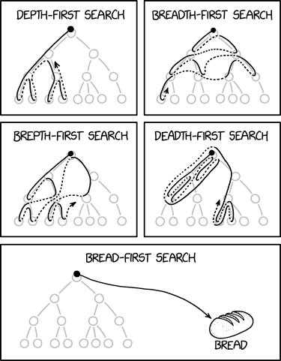
Section 1: ToA
https://xkcd.com/2407/: A death-first search is when you lose your keys and travel to the depths of hell to find them, and then if they're not there you start checking your coat pockets.

Slide 4
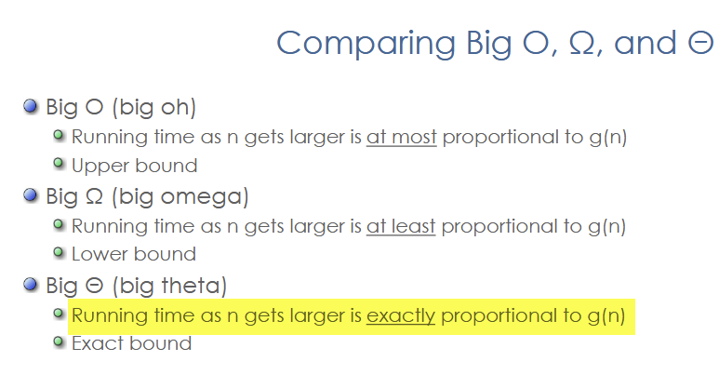
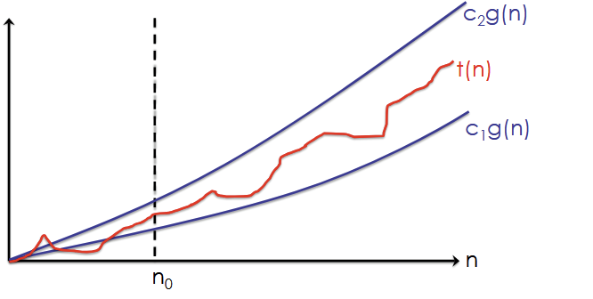
Question 1a
a) if T(n) = n^2 + (log n)^2, then T(n) is in …
n^2 is going to dominate, thus will be in O(n^2). Moreover, it will be in Θ(n^2), because it also can’t be faster than n^2

Slide 5
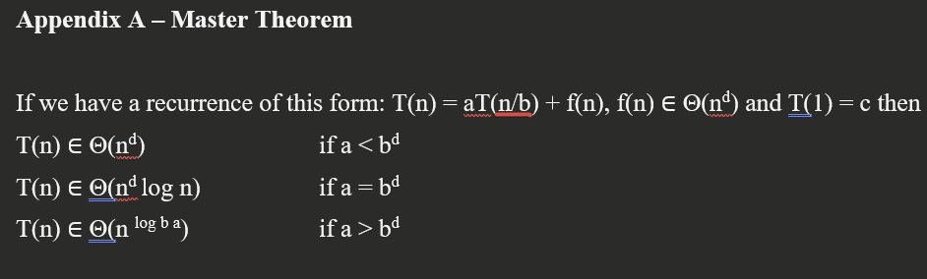
Question 1b
b) We can use the Master Theorem to solve a recurrence of the form
T(n) = aT(n-b) + f(n), where f(n) is in Θ(n^d)
Master theorem is for n / b (divide), not n - b (minus) as per the question. False

Slide 6
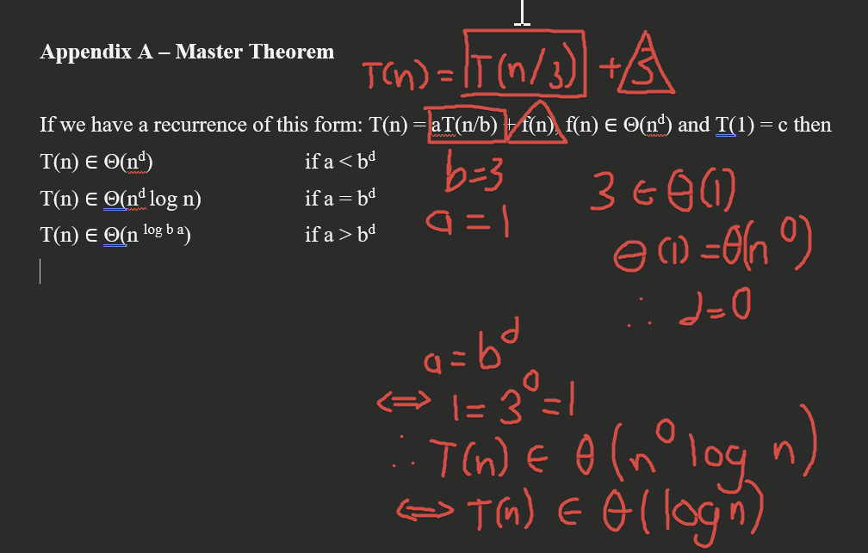
Question 1c
c) Given T(n) = T(n/3) + 3, the solution to the recurrence is in

Slide 7
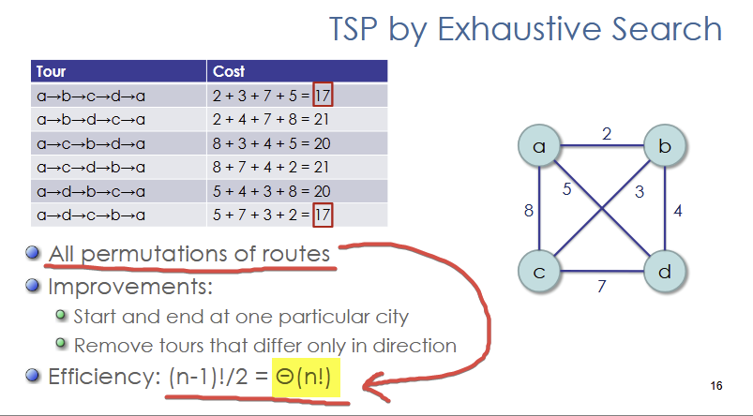
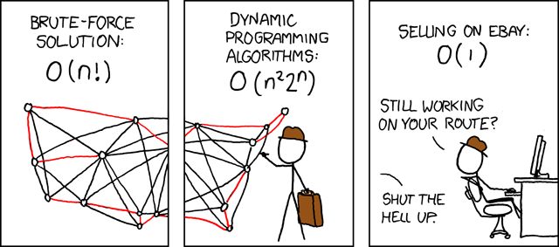
Question 1d
d) Solving the Travelling Salesman (TSP) problem, between n cities, by brute force enumeration (exhaustive search) is in
https://xkcd.com/399/ What's the complexity class of the best linear programming cutting-plane techniques? I couldn't find it anywhere. Man, the Garfield guy doesn't have these problems...

Slide 8
Question 2a
You are given an unsorted array of n elements and asked to find the kth smallest element.
Kth smallest element example: 4th smallest element of [1, 5, 19, 2, 3, 6] is 5.
Your mind should immediately jump to quickselect! Full mark answer mentions partitioning separating the list into left < pivot and right > pivot and also that this is recursive or repeated

Slide 9
Question 2a - common mistakes
Finding the absolute smallest and not k-th smallest (0 marks). Read the question!
Algorithm which is equivalent to a presort (0 marks). Read the question!
Mentioning binary search (the array is not sorted...)
Just mentioning (not explaining) quickselect (0.5 marks)
Designing a custom O(nk) or O(n^2) algorithm (0.5 marks if poorly explained, 1 mark if clear)
  We want you to learn the notes and also use efficient solutions
For quickselect algorithms, not being specific about the property that the partitioning enforces (one half <p and one >p)
For quickselect, not mentioning partitioning and only pivoting, or not saying that it is repeated or recursive

Slide 10
Question 2b
b) Why will this approach not always be better than presorting?
For quickselect: the partitioning scheme can degenerate (0.5 marks) to a complexity of O(n^2) in the worst case (0.5 marks)

Slide 11
Question 2b - common mistakes
Explaining why your bad algorithm in A) is worse... we know it’s bad... this is not new information. You could just design a purposefully bad algorithm to try get marks on B for explaining how it’s bad. (Specific enough answers with time complexities for both can get 0.5 marks)
The question is about time complexity, not correctness. If you say “my algorithm could have cases where it doesn’t work”, your answer for A is wrong and B is not answering the question...
Not comparing to presort as is asked in the question (0 marks unless you mention that the worst case is O(n^2), then 0.5 marks)
Not being specific about time bounds (0.5 marks only)
SORTING IS N LOG N, not log n or n. This also has to be counted toward the presort approach’s efficiency (we can’t consider sorting to be free)

Slide 12
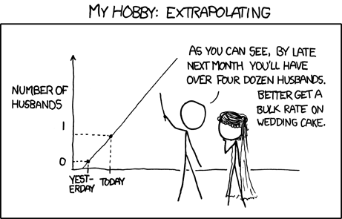
Question 3
3) Why does interpolation search not always reduce the search domain by a constant factor like binary search?
Because the search is estimating the next key position based on the current value, so depending on that current value, you could chop off a lot more of the array in some cases - therefore the factor is not constant. (1 mark)
This is unlike binary search, which uses the midpoint even time, which is constant (1 mark).
Common mistake: forgetting to compare to binary search!
https://xkcd.com/605/: By the third trimester, there will be hundreds of babies inside you.

Slide 13
Question 4
You are given an array of elements [s1, ..., sn] and asked to write an algorithm to sum all the elements. Your classmate claims you can improve on brute force summation (n-1 adds) by using a simple divide and conquer algorithm to do the summation in “log n operations”! Show that this is not true by defining and solving the recurrence relation for the number of additions A(n) required to compute the full sum using the obvious divide-and-conquer approach for n elements. After you have defined the full recurrence relation, you can assume that n = 2^k to solve it – you may use the Master Theorem.

Slide 14
Question 4 cont.
You can look in the memo for a full solution, but the gist is that you are not really saving any time since you have to add to recombine regardless. E.g. 1, 2, 3, 4, 5, 6, 7, 8 would be ((1 + 2) + (3 + 4)) + ((5 + 6) + (7 + 8)) which is the same as 1 + 2 + 3 + 4 + 5 + 6 + 7 + 8 if you count the +s
Common mistakes:
Not defining problem and recurrence relationship before plugging values in the master theorem
Not defining a base case
Not including additional add operation combining problem halves
Not taking into account odd array length – why floor and ceil is needed (directly from textbook)

Slide 15
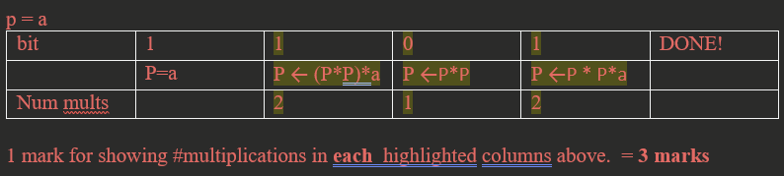
Question 5
5) Use Horner’s algorithm for exponentiation to compute the number of multiplies needed to compute a^13
You must use HORNER’S algorithm, not inspection or divide & conquer. To start, we convert the power, 13, to binary to execute the algorithm. 13 = 8 + 5 = 8 + 4 + 1 = 2^3 + 2^2 + 2^0. So, 13 in binary is 1101 (1 mark). Then we execute the algorithm - table itself is optional (3 marks)

Slide 16
Question 5 - common mistakes
Just showing it by repeated, grouped multiplication – needs to be the actual algorithm, which involves converting to binary amongst other things (0 marks)
A lot of people used repeated, grouped multiplication and got the wrong answer regardless
  x^2 = x * x = two multiplies
  x^5 = x * x * x * x * x = four multiplies
  Extrapolating, x^13 has 12 multiplies, not 13 as a lot of people said!
Showing code did not answer the question - please read the question - it says to apply Horner’s algorithm! (0 marks)
Just stating the answer - you need to apply the algorithm (0 marks)

Slide 17
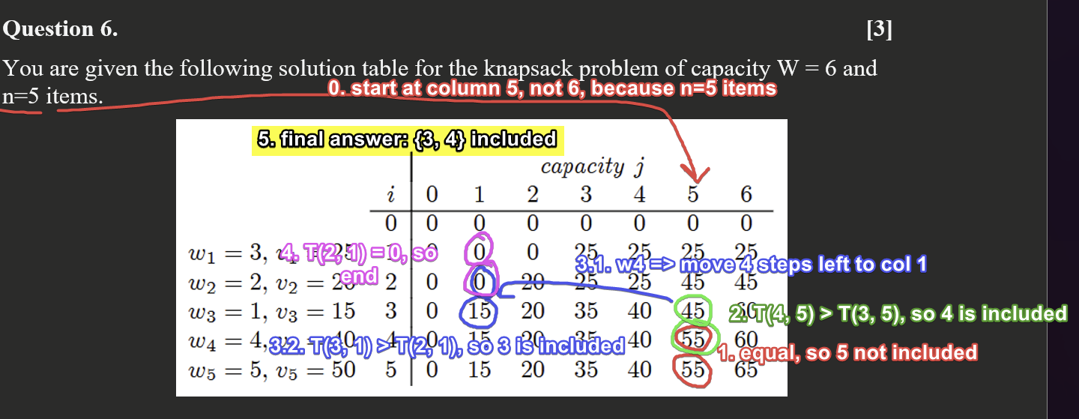
Question 6
Use this information determine the most valuable items that can fit into a knapsack of capacity W = 5.

Slide 18
Question 6 - common mistakes
Not changing column when an item is added
Changing column based on the value, not the weight – still got to the right answer in this case but not always correct. Capped at 2
Just writing down an algorithm but not applying it to this question
Using brute force logic, the wrong algorithm, or no algorithm to get to the answer

Slide 19
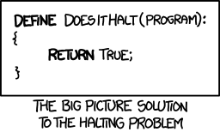
Section 2: ToC
http://xkcd.com/1266 I found a counterexample to the claim that all things must someday die, but I don't know how to show it to anyone.

Slide 20
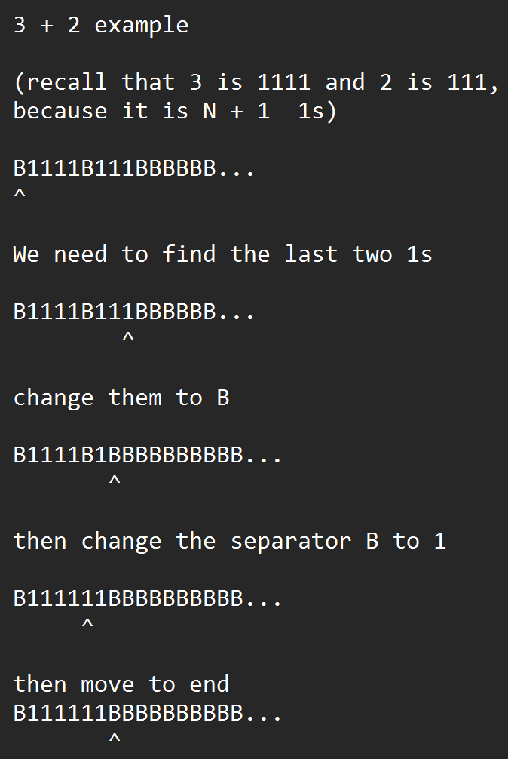
Question 7a
7a) Using B to represent a blank cell, draw a transition diagram for a Turing Machine with alphabet {B,1} that does natural number addition for unary numbers, and stops with the tape head at the cell immediately right of the total. A number N is represented by a string of N+1 consecutive 1s. The tape head will start on a blank cell, followed by the two numbers, with a single blank cell between them.
Basically, we need to find the last two 1s in the second number, flip it to B, and change the separator B to 1 as well. Then move one right of total (Last two 1s because it is N+1 consecutive 1s per number).

Slide 21
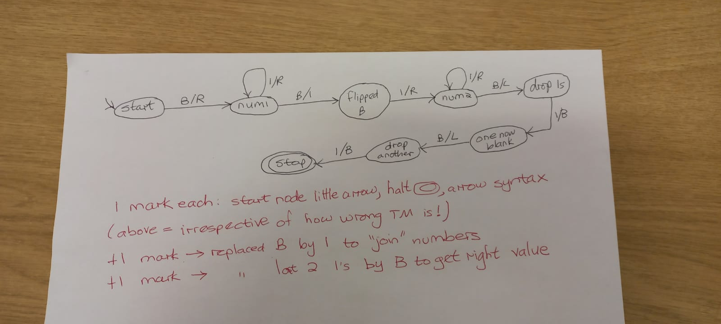
Question 7a - soln

Slide 22
Question 7a - marking + common mistakes
This was a tough question, so it’s worth discussing how it was marked.
Old syntax ok as long as not mixed with new
+3 marks for being able to draw any correct TM syntax
  +1 for start
  +1 for halt
  +1 for arrow syntax
+1 mark for replacing last 1 with B
+1 mark for replacing separator B with 1
Common mistakes included:
Mix of old and new notation for lines (B/R vs B;B;R)
NOTE A MARKING MISTAKE: IF YOU GOT -1 MARK FOR REMOVING TWO 1s, YOU SHOULD GET THE MARK - TALK TO ME AT QUERY

Slide 23
Question 7b
7b) How many rows would your Turing Machine above have in its State Table?
This is simply the number of transitions (arrows), not including the arrow with no origin to mark the start state. This was marked according to your turing machine, so if you got the answer wrong, you didn’t count correctly

Slide 24
Question 7c
7c) Give an example of any one row in your Turing Machine’s State Table.
Also marked from your own TM. You needed the following components:
Current state (where the arrow starts)
Next state (where the arrow ends)
Current tape symbol - what is read from the tape (the symbol before the / in the arrow or arc)
Action - what is written to the tape (the symbol after the /)
No partial marks were awarded for this question

Slide 25
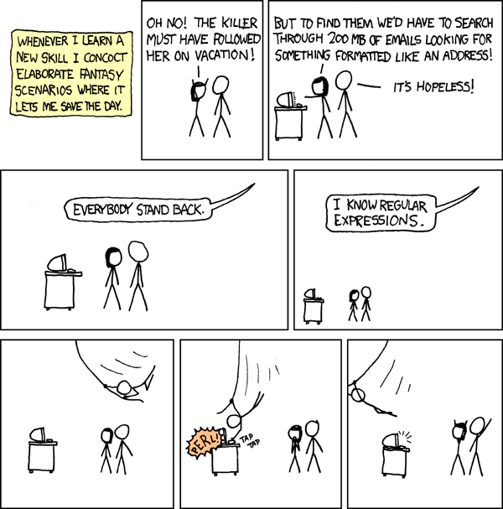
Question 8
8) Give a regular expression (regex) that accepts the language AskLess:
AskLess = { w | w comprises 2 binary numbers separated by either “<” or “<=” }
Basically we need to match one binary number (0s and 1s), < or <=, and then another binary number. For example:
[01]+<=?[01]+
https://xkcd.com/208/: Wait, forgot to escape a space. Wheeeeee[taptaptap]eeeeee!

Slide 26
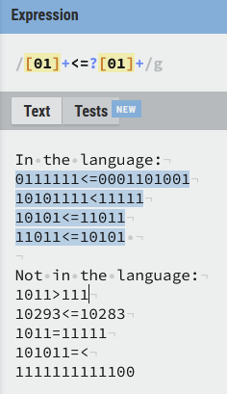
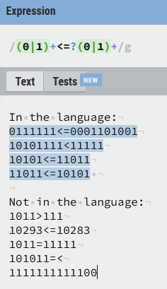
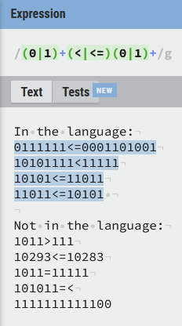
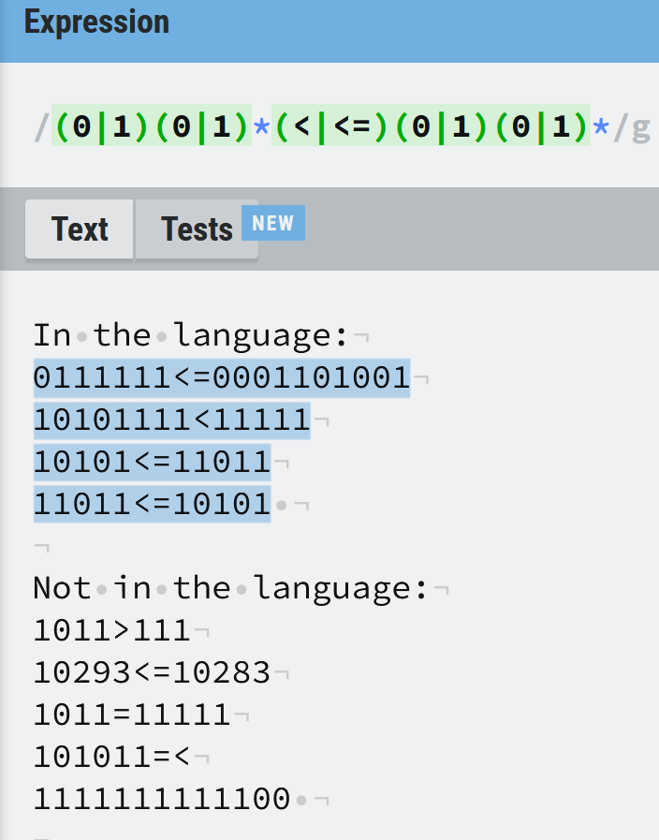
Question 8 - some valid solutions

Slide 27
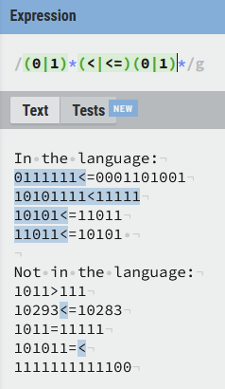
Question 8 - common mistake 1
Using the * (Kleene closure) symbol rather than + (positive closure)
This matches zero or more. But, empty string is not a binary number.

Slide 28
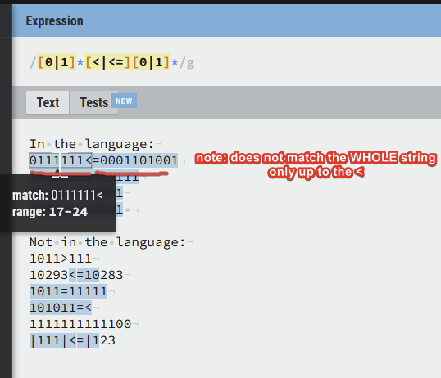
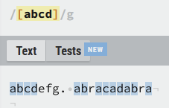
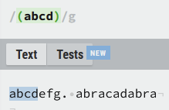
Question 8 - common mistake 2
Using square brackets rather than round
[] is a character class. () is a capture group.
This means [abcd] matches one of abcd. (abcd) groups a match for the exact string “abcd”. So [0|1] is matching 0 or the literal pipe |, or 1 (not 0 or 1)

Slide 29
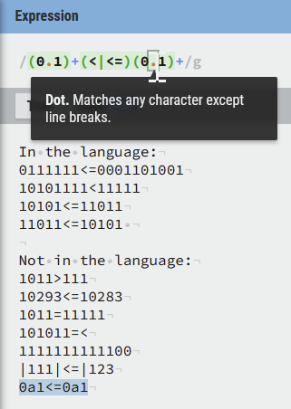
Question 8 - common mistakes 3
Students not correctly using the OR pipe for (1|0) – using (1.0)
In most common regex dialects (yes, there are dialects), . refers to “any character” (sometimes except linebreaks, it depends on the mode for sed for instance)

Slide 30
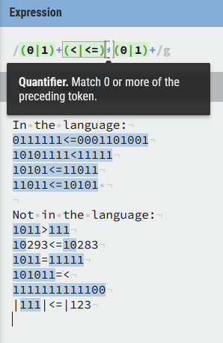
Question 8 - common mistakes 4
Incorrect placements of kleene closures
To be honest, I don’t really what exact cases the tutors meant by this, but putting it pretty much anywhere where it shouldn’t be could be pretty catastrophic…

Slide 31
Question 9
9) We know there are languages no Turing Machine can recognize because (A) the set of all languages is uncountably infinite; and (B) the set of all Turing Machines is countably infinite. In one sentence, explain briefly how we know (B) is true.
Every TM can be encoded as a binary number (0.5 marks) and binary numbers (=integers) are countable (0.5 marks)

Slide 32
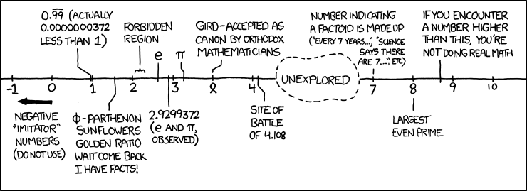
Question 9 - common mistakes
Students mentioning real numbers as being countable
Students using the diagonalization theorem (not for TMs being countable)
Students mentioned the infinite tape as a reason for there being countable infinite TM (a finite TM can both write + read infinite tape with no issues - e.g. one that just flips 1s to 0s forever)
https://xkcd.com/899/: the Wikipedia page List of Numbers opens with "This list is incomplete; you can help by expanding it."

Slide 33
Question 10
10) Which of the following statements are false?
If the input of a problem is of size N, then the lower bound of that problem must be at least (N) - False, e.g. binary search
[Guess two digit was removed]
Any language that is decidable is also acceptable - True. Use the TM that decides the language (by definition of decidable), then accept.
If problem A has a lower bound of N log N, and we can show that problem B is reducible to problem A in linear time, then problem B also has a lower bound of N log N - False - we need to show A is reducible to B for this

